Slide 1

Sql (structured query language)
By VANSH KUMAR THAKUR
COURSE: M.SC DATA SCIENCE
SEMESTER: FIRST ( I ST )

Slide 2
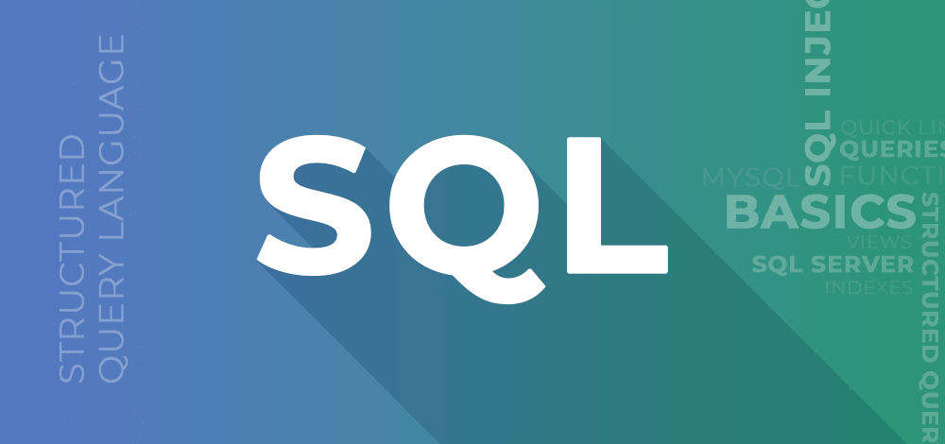
STRUCTURED QUERY LANGUAGE
SUBMITTED BY:
VANSH KUMAR THAKUR
COURSE:
M.SC DATA SCIENCE
SEMESTER:
FIRST ( I ST )
SUBMITTED TO:
MR. NITISH
(ASSISTANT PROFESSOR)

Slide 3

Structured query language (SQL) is a programming language for storing and processing information in a relational database.
A relational database stores information in tabular form, with rows and columns representing different data attributes and the various relationships between the data values.
You can use SQL statements to store, update, remove, search, and retrieve information from the database. You can also use SQL to maintain and optimize database performance.

Slide 4
SQL COMMANDS
Structured query language (SQL) commands are specific keywords or SQL statements that developers use to manipulate the data stored in a relational database. You can categorize SQL commands as follows.
Data definition language:
Data definition language (DDL) refers to SQL commands that design the database structure. Database engineers use DDL to create and modify database objects based on the business requirements. For example, the database engineer uses the CREATE command to create database objects such as tables, views, and indexes.
Data query language:
Data query language (DQL) consists of instructions for retrieving data stored in relational databases. Software applications use the SELECT command to filter and return specific results from a SQL table.

Slide 5
SQL COMMANDS
Data manipulation language:
Data manipulation language (DML) statements write new information or modify existing records in a relational database. For example, an application uses the INSERT command to store a new record in the database.
Data control language:
Database administrators use data control language (DCL) to manage or authorize database access for other users. For example, they can use the GRANT command to permit certain applications to manipulate one or more tables.
Transaction control language:
The relational engine uses transaction control language (TCL) to automatically make database changes. For example, the database uses the ROLLBACK command to undo an erroneous transaction.

